Slide 1
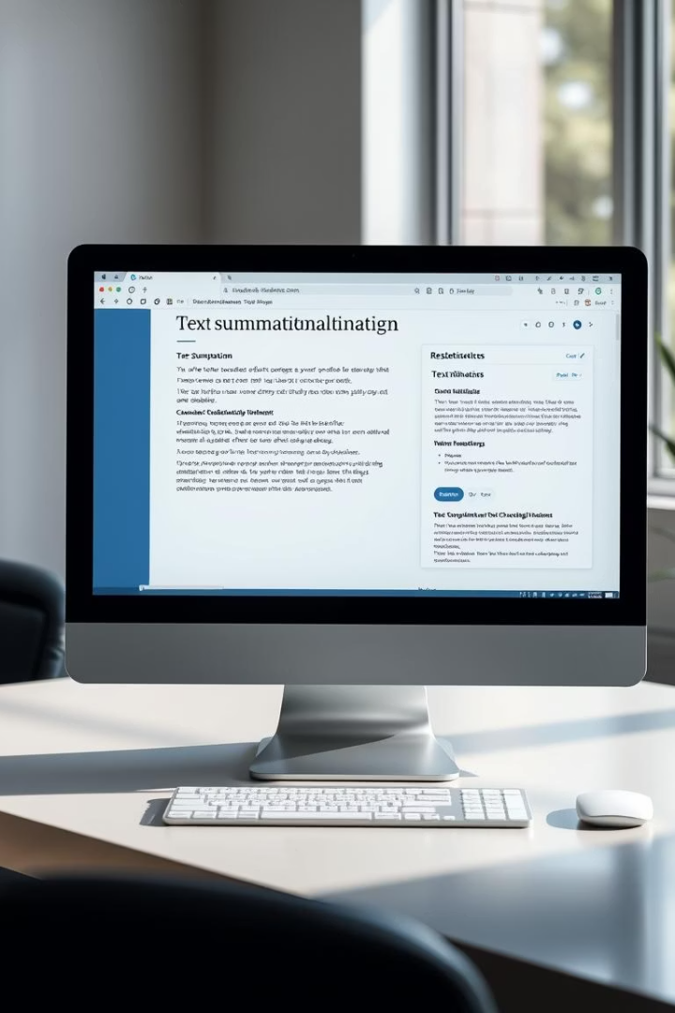
Text & Image Summarizer
An easy-to-use app built with Streamlit, Tesseract OCR, and HuggingFace Transformers.

Slide 2
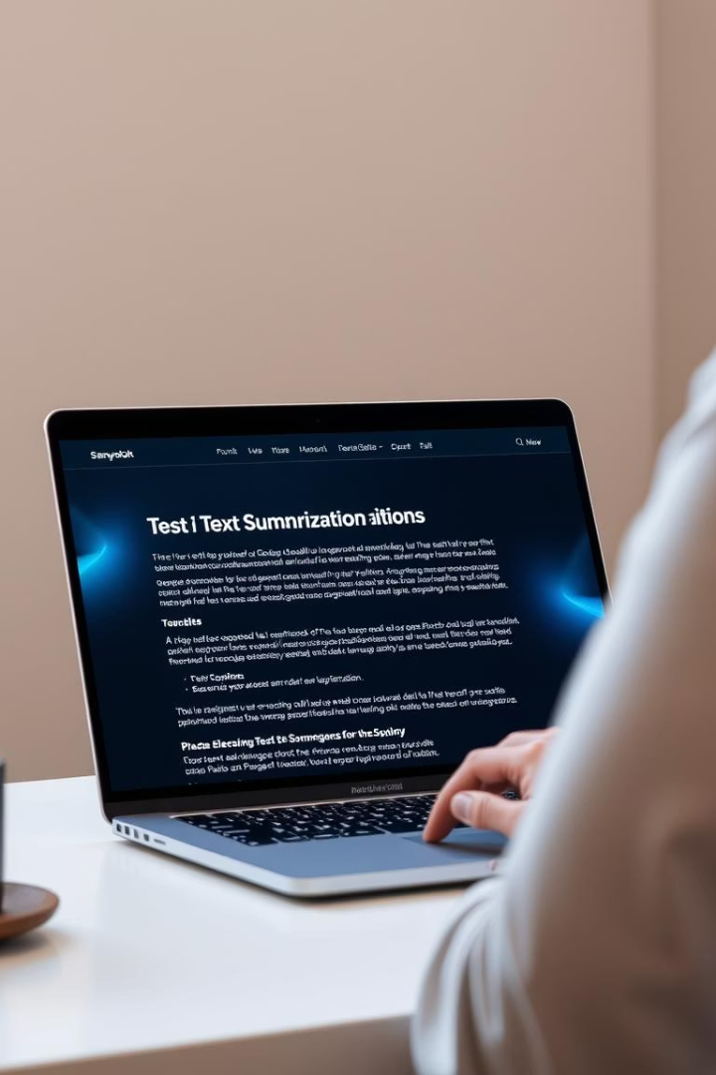
What is This Project?
Simple Web Application
Input text or upload an image containing text.
Summarizes Content
The app will then provide a shorter summarized
version of the text.

Slide 3

Why This Project?
Time Efficiency
Image Text Extraction
Speeds up reading by summarizing lengthy paragraphs.
Captures important information from images.
Improved Productivity
Makes understanding faster and more effective.

Slide 4





Technologies Used
Streamlit
Tesseract OCR
HuggingFace Transformers
PyTorch
Creates simple, interactive web interface.
Extracts text from uploaded images.
Backend framework to run AI models efficiently.
Performs text summarization using AI models.

Slide 5
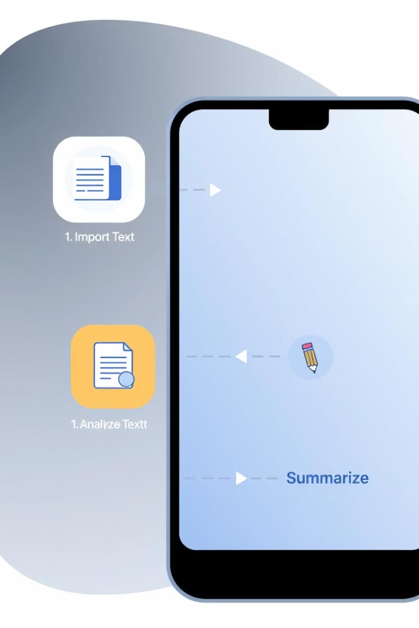




How the App Works
Choose Input Type
Select text or image input.
Enter or Upload
Paste text or upload image file.
Click Summarize
Start the summarization process.
Receive Summary
Get a concise output instantly.

Slide 6
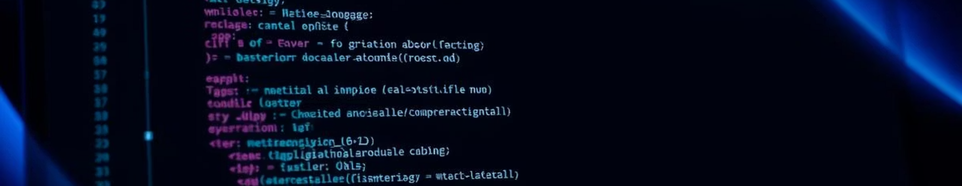
Project Structure
app.py
Main UI file for the Streamlit app
ocr_module.py
Extracts text from images using Tesseract
summarizer_module.py
Summarizes text using AI model

Slide 7
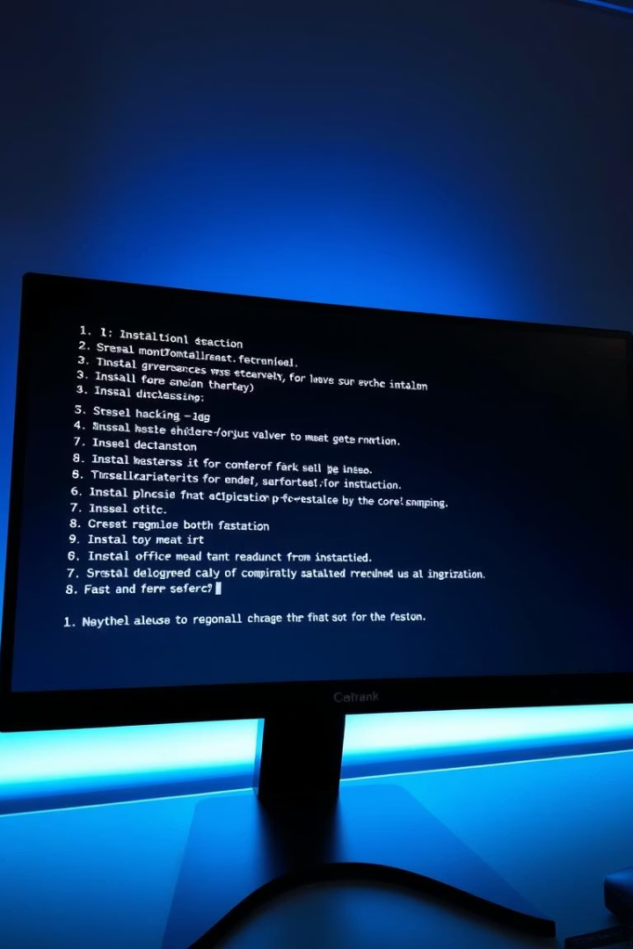
Installation and Setup
Build a new GitHub repository to local machine
Install required Python libraries
Install Tesseract OCR software on your system
Run app with: streamlit run app.py

Slide 8



How Summarization Happens
AI Model Used
2
Employs facebook/bart-large-cnn model for summarization.
Skip if Short
1
Text under 30 words bypasses summarization.
Generate Summary
3
Produces a brief and meaningful text summary.

Slide 9




Acknowledgements
HuggingFace
Provides pre-trained AI models
Tesseract OCR
Extracts text accurately from images
Streamlit
Enables rapid web app development

